Slide 1
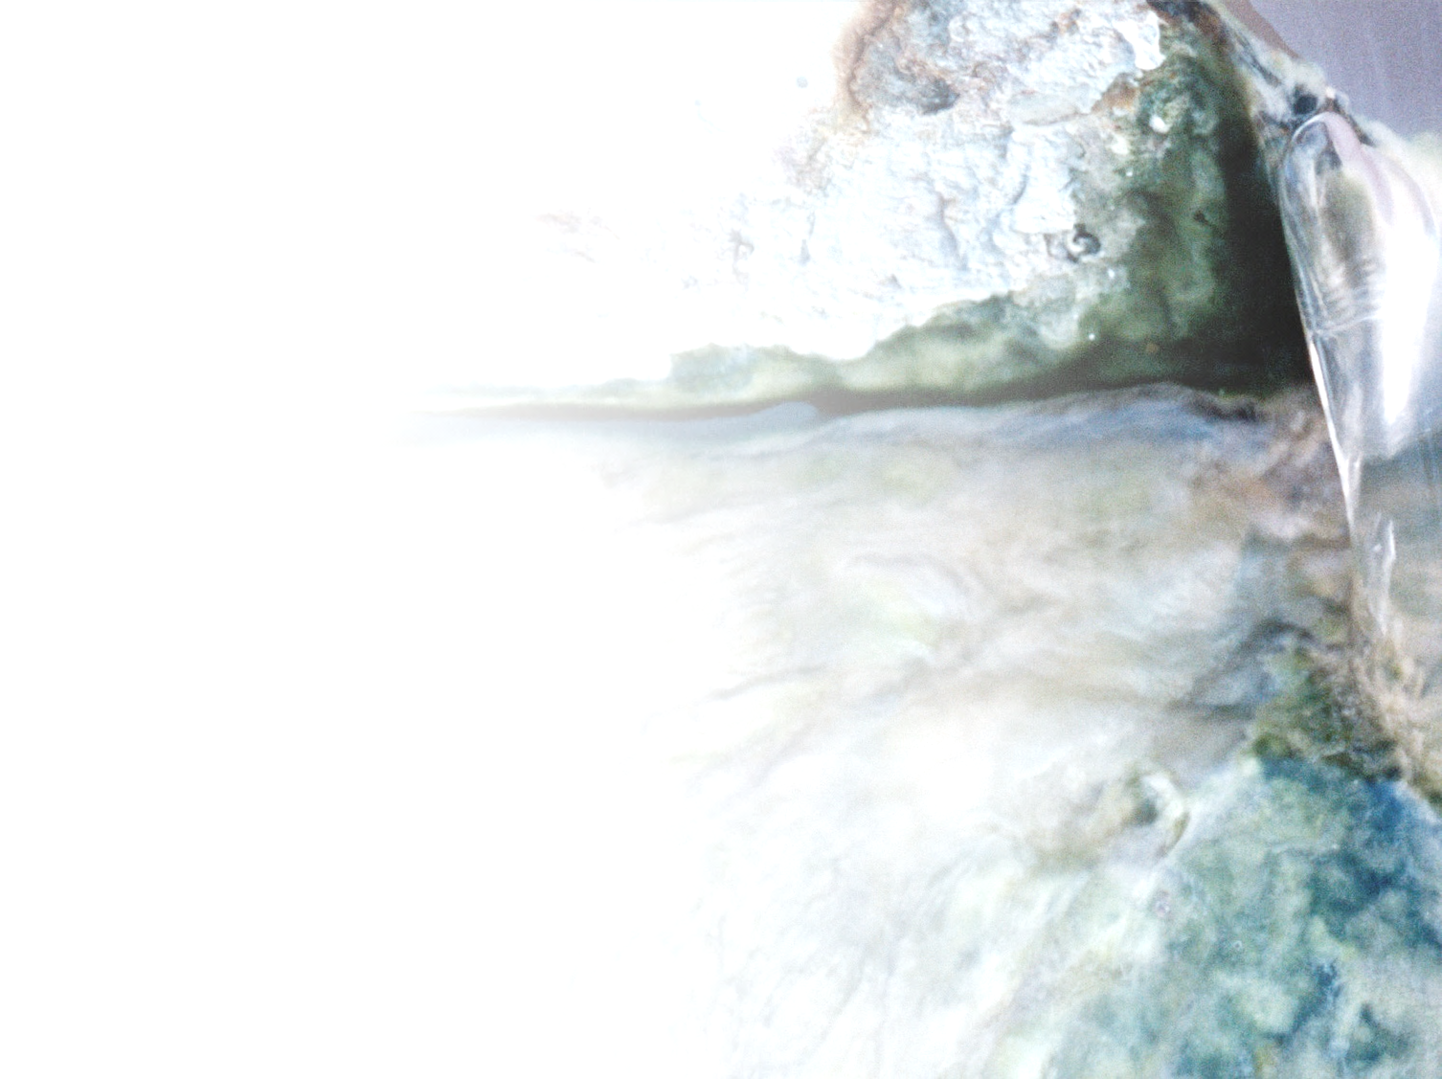




Hands on: Basic analysis of microbial communities using the ampvis2 R package
Morten Kam Dahl Dueholm
10th IWA Microbial Ecology and
Water Engineering Specialist Conference 2023
Workshop:
Application of the MiDAS database for microbial community analyses
Center for Microbial Communities
Department of Chemistry and Bioscience
Aalborg University, Denmark
@msdueholm
@mkddueholm.bsky.social

Slide 2
Setting up your computer
Make sure you have installed R and Rstudio
Download data for the workshop
https://github.com/msdueholm/MEWE2023_workshop/tree/main
Go into Rstudio
Create a new Rscript for today’s workshop
Install ampvis2
install.packages("remotes")
remotes::install_github("kasperskytte/ampvis2")
Check out the ampvis2 homepage
https://kasperskytte.github.io/ampvis2/articles/ampvis2.html

Slide 3
Loading Ampvis2 and the amplicon data
library(ampvis2)
d <- amp_load(otutable = "path/to/otutable.csv",
metadata = "path/to/samplemetadata.xlsx",
taxonomy = "path/to/taxonomy.csv")
Do this for four dataset
V13 amplicon data with Silva taxonomy
V13 amplicon data with MiDAS 5.1 taxonomy
V4 amplicon data with Silva taxonomy
V4 amplicon data with MiDAS 5.1 taxonomy

Slide 4
Check your data
Write the name of the ampvis2 object

Slide 5
Subset and rarefy the data
D <- amp_filter_samples(d, minreads = 10000, rarefy = 10000,
normalise = TRUE, removeAbsentOTUs = TRUE)

Slide 6
Creating your first heatmaps
amp_heatmap(d, group_by = “City")
Check and compare date set
Check out ampvis2 page for additional options
Try to sort based on a specific city (sort_by)
Examine the effect of tax_show, tax_aggregate, showRemainingTaxa.

Slide 7
Creating your first boxplot
amp_boxplot(d, tax_show = 25)
Check out ampvis2 page for additional options
Try to play with the options

Slide 8
Creating your first ordination
amp_ordinate(
d,
type = "pcoa",
distmeasure = "bray",
sample_color_by = “City",
sample_colorframe = TRUE,
sample_colorframe_label = “City")

